Slide 1


Domain: Transportation & Mobility

Slide 2

Company Outline:
Goodcabs is providing cab services since two years in tier-2 cities in India and has gained a strong foothold in public transportation domain. Goodcabs is committed to supporting the local drivers and helping them make a sustainable living in their hometowns while ensuring excellent service to passengers. The company has set ambitious performance targets for 2024 to drive growth and enhance customer satisfaction.
Target market: All citizens of tier-2 cities in India

Slide 3
Problem Statement
Problem Statement: As the company sets ambitious goals for 2024, Goodcabs need the data-driven insights to make better decisions in expanding their business and consumer satisfaction. The company needs to analyze the useful metrics used in transportation domain like total trips, monthly demand growth, fare per trips, passenger ratings to identify the growth potentials and the shortcomings of their services.

Slide 4
Ad-Hoc requests and answers

Slide 5
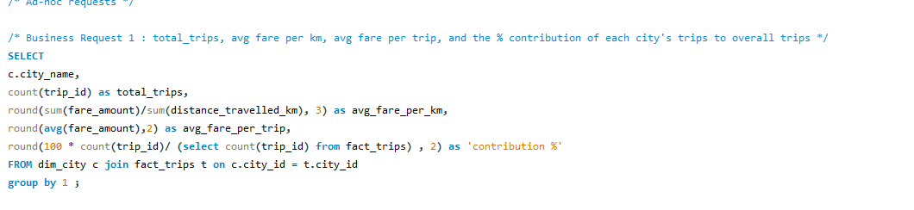
Q1. City-level fare and trip summary reports

Slide 6
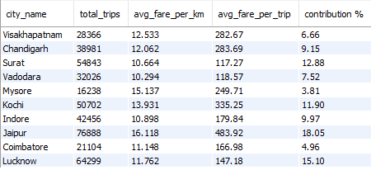
Q1. City-level fare and trip summary reports

Slide 7

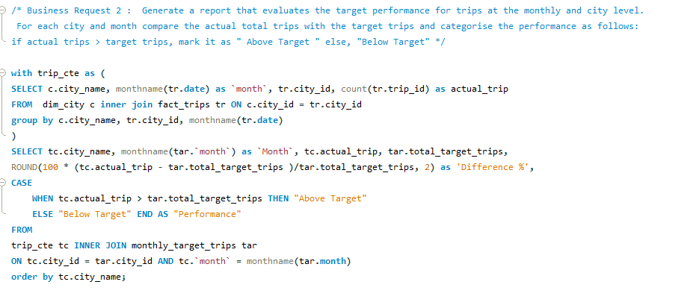
Q2: Target performance report at the monthly and city level

Slide 8
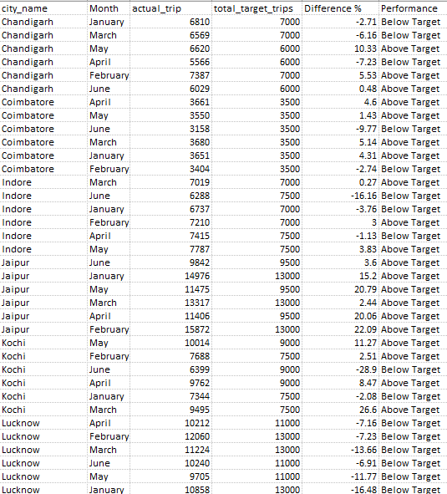
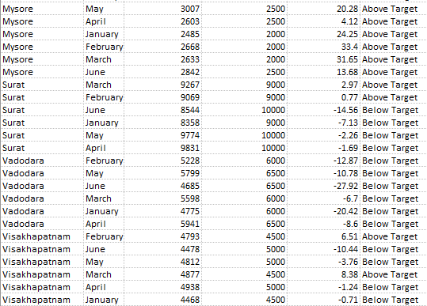
Q2: Target performance report at the monthly and city level

Slide 9
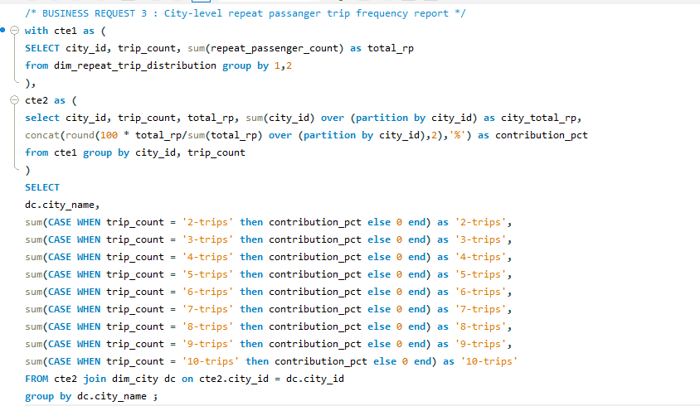
Q3. City-level Trips Repeat Passenger Trip Frequency report

Slide 10
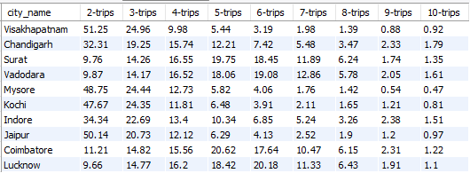
Q3. City-level Trips Repeat Passenger% and Trip Frequency report

Slide 11
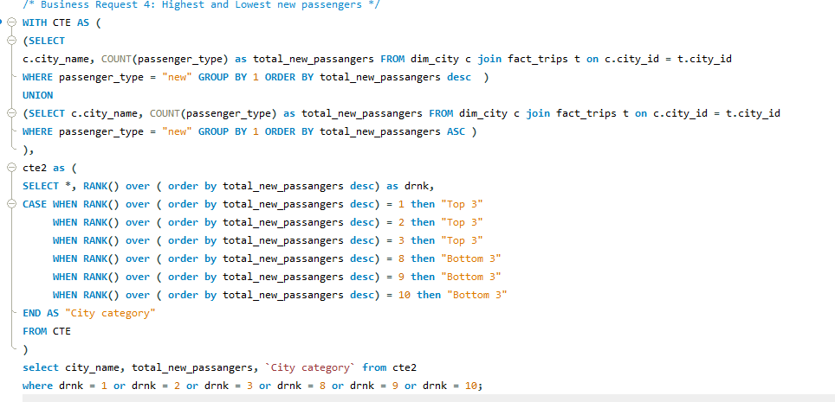
Q4. Cities with highest and lowest new passengers

Slide 12
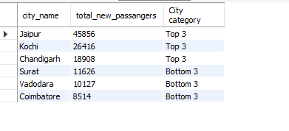
Q4. Cities with highest and lowest new passengers

Slide 13
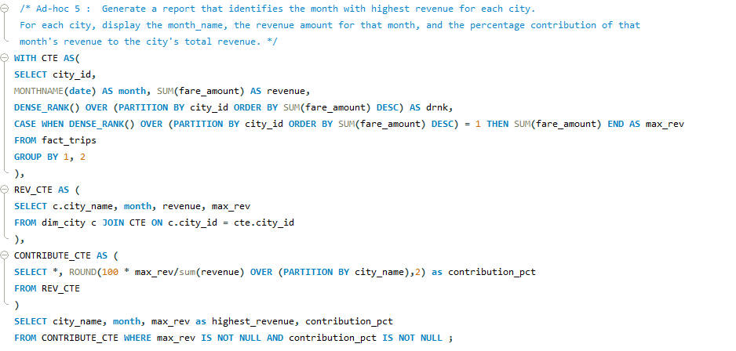
Q5. Month and highest revenues in cities

Slide 14
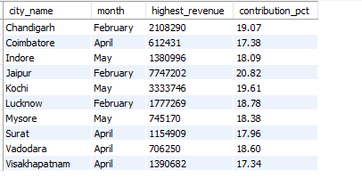
Q5. Month and highest revenues in cities

Slide 15
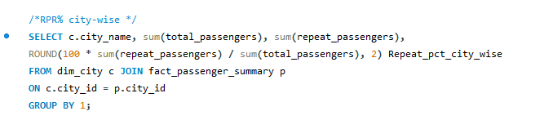
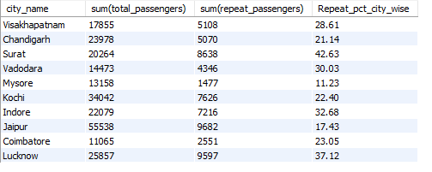
Q6: Repeat Passenger Rate analysis

Slide 16
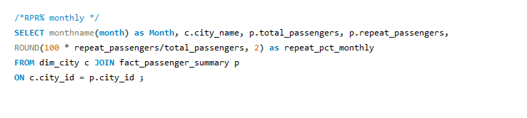
Q6: Repeat Passenger Rate analysis

Slide 17
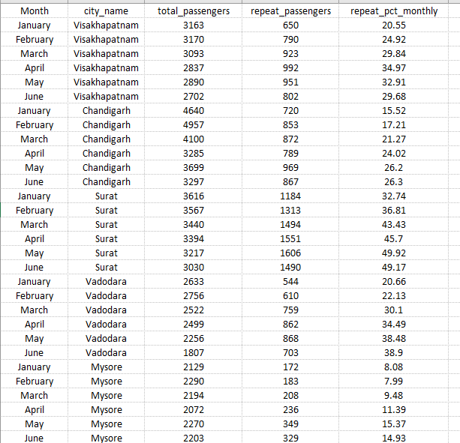
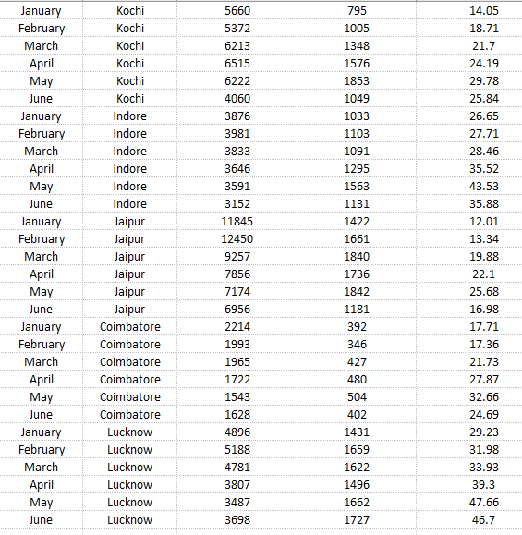
Q6: Output of Repeat Passenger Rate analysis monthly

Slide 18
Let’s look at the
Dashboard

Slide 19
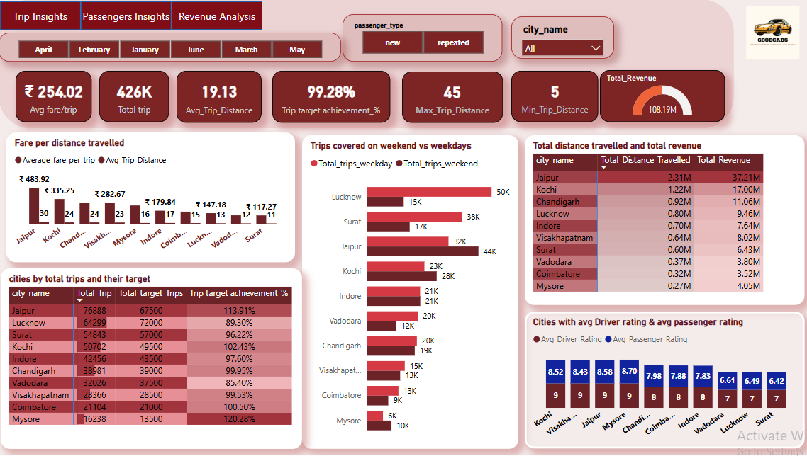
Trip Insights

Slide 20
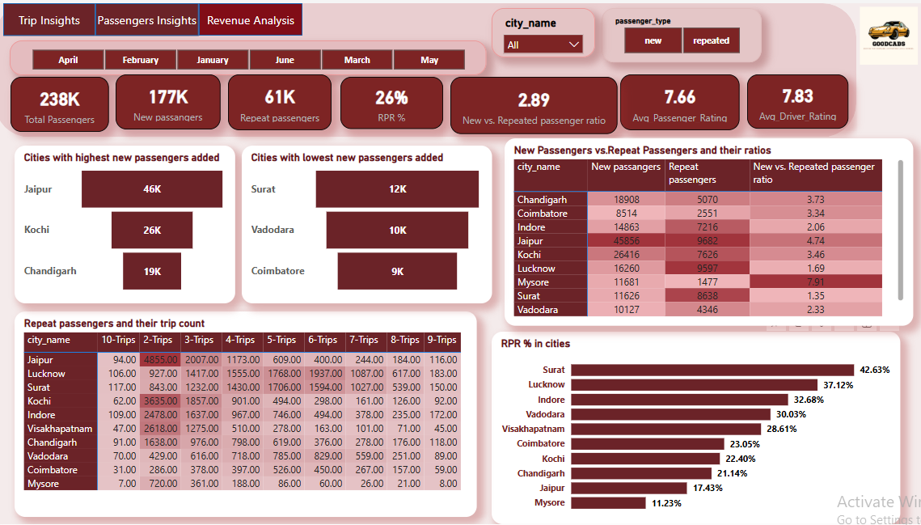
Passengers Insights

Slide 21
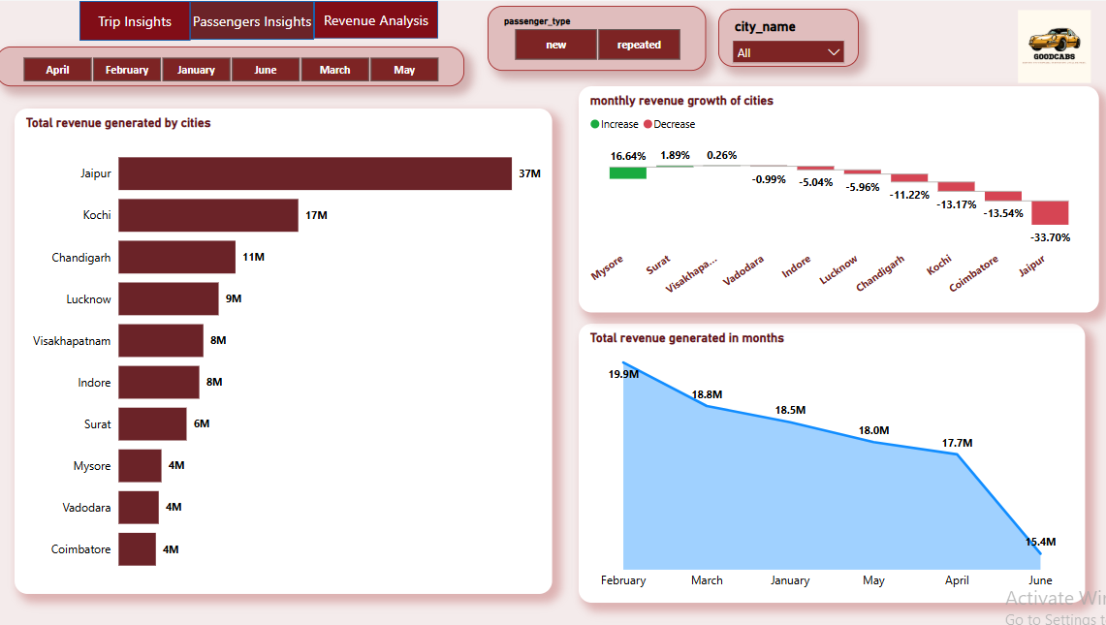
Revenue Insights

Slide 22
Further Analysis and Recommendations

Slide 23
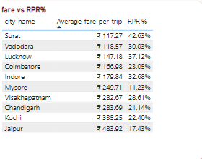
Q1: Factors influencing RPR%
Pricing and Affordability: Reasonable pricing compared to competitors and other modes of transport.
Polite and professional drivers: Good communication skills and customer-friendly behavior.
Impact of price rise: High fare leads to reduction of repetitive rides by passengers.
Surat, Vadodara, Lucknow having the least Avg fare, have the highest RPR%
Chandigarh, Kochi, Jaipur having the highest Avg fare, have the lowest RPR%

Slide 24
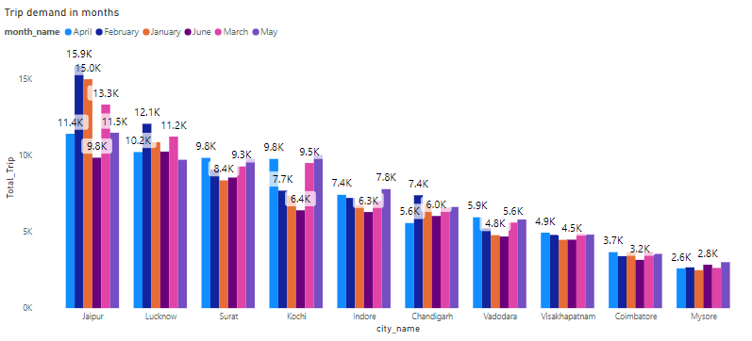
Q2: Tourism vs Business demand impact:
Popular Tourism spot like Jaipur and Business hub like Lucknow, Surat have the highest trip demand.

Slide 25
Q3: Emerging mobility trends and Goodcabs adaptation: What emerging mobility trends (like, EV adaptation, green energy use) are impacting the cab service market in tier-2 cities? Should Goodcabs consider integrating electric vehicles to stay competitive?
Consumers in Tier-2 cities are particularly value-conscious, which aligns well with the cost advantages of EVs.
Tier-2 cities are mostly compact urban geographic areas and that’s why EV is ideal option in these areas for travelling shorter distances. Low maintenance cost make the rides affordable and reduces emission too.
Around 60% growth in EV sales in tier-2 cities specially Jaipur in FY-24, it’s expected to grow upto 66% by FY25.

Slide 26
Q4: Partnership opportunities with Local Businesses
Goodcabs must tie-up with the busiest railway stations, airport as these are the centers from where people move towards different destinations like offices, hospitals, tourist spots, colleges etc. More rides will generate more revenue
Installing any kiosk at the exit area of hotels can influence the customers to book any cab. Goodcabs must adapt this idea to add more new customers.

Slide 27
Q5: Data collection for enhanced data-driven decision
Starting-time and ending-time of a journey is required to determine whether the journey is short or long, the busiest hours in a day. Time is a crucial data for analyzing consumer behavior.
Demographics like gender, age group, their pickup location, destination are required to find the places those are frequently travelled
The data of the drivers refusing ride request, or the passengers cancelling cabs can help to identify the pain-points and it will help to solve those problems. Such pain-points like heavy traffic jams, extreme weather conditions

Slide 28
Key Insights generated:-
Jaipur is a tourism-focused city that has achieved the highest trips of 76888 with 2nd Lowest RPR 17.43%
In February, Goodcabs have generated highest revenue of 19.9 M and in June, the least revenue of 15.4 M
Lucknow is the business-focused city that has highest trips of 49617 on weekdays.
Business-focused cities Lucknow and Surat has witnessed the highest RPR% of 37.12% and 42.63% respectively

